Slide 1
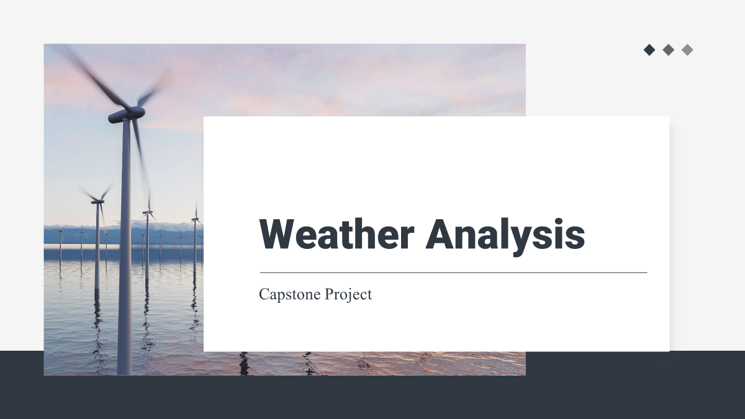

Table of contents
01
04
02
03
Purpose Statement
PowerBI Problem statement
The owerview of this project
To make the problems less complex using visuals
MECE
EDA Problem Statement
Initial analysis of the project
To get the in depth analysis of the project

Slide 2
Table of contents
01
04
02
03
Purpose Statement
PowerBI Problem statement
The owerview of this project
To make the problems less complex using visuals
MECE
EDA Problem Statement
Initial analysis of the project
To get the in depth analysis of the project

Slide 3

Purpose statement
01

Slide 4

Purpose statement
To gain insights from weather trends, seasonal variations and correlations between attributes, consider using tools like Excel and SQL for analysis. Additionally, you can develop a Power BI dashboard weather monitoring and historical weather analysis. This will help you visualize and understand weather patterns and their impact on your business or personal interests.

Slide 5
Dataset name and its contents
03
04
05
01
02
City attributes
Humidity
Pressure
Temperature
Weather description
It provides info about each city that is covered in the dataset.
Contains hourly data representing the humidity levels in each city.
Provides hourly data about the air pressure levels in each city.
Contains hourly temperature data for each city.
Provides a textual description of the weather for each city on an hourly basis.
06
07
Wind speed
Wind direction
Contains data about the direction from which the wind is blowing on an hourly basis for each city.
Provides hourly data about the speed of the wind in each city.

Slide 6
MECE Analysis
02

Slide 7
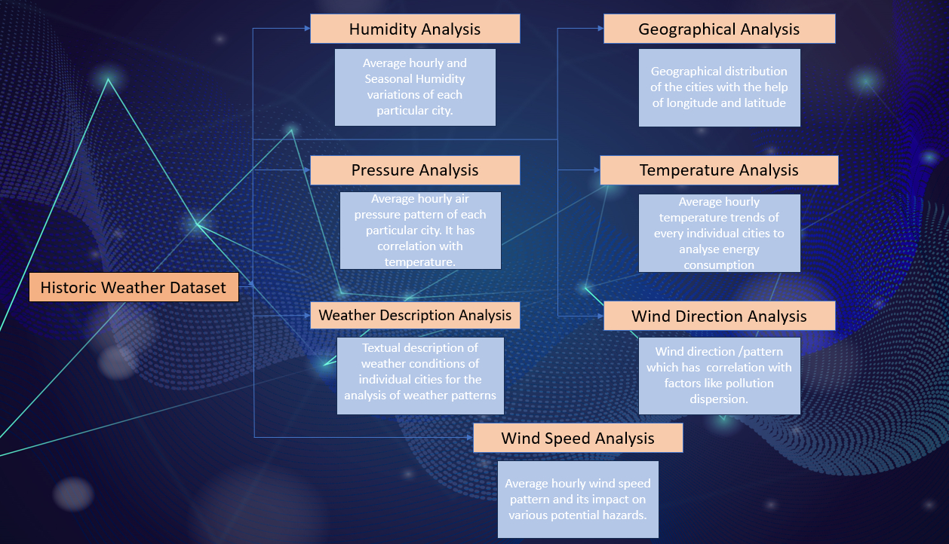
Analytical framework

Slide 8
Data transformation
To transform the given data for effective analysis, we will create five new tables from the existing data tables:
The first table, City_attributes, will contain city_id, country_id, latitude, and longitude, providing metadata about each city.
City_lookup will be the second table, containing the city name. This table will be linked to City_attributes and final_fact using city_id.
The third table, Country, will consist of the country name, which will help in mapping cities to their respective countries.
The fourth table, date_lookup, will contain date details extracted from the Datetime column in the original tables. This will enable better organization and management of date-related data.
The fifth table, named final_fact, will be the main fact table that will include all the weather attributes, such as weather description, temperature, pressure, humidity, wind speed, and wind direction. This table will be linked to City_attributes, date_lookup, country, city_lookup and time_lookup.
The time_lookup table, which will be the sixth table, will have the time extracted from the Datetime column in the original tables. These new tables will be normalized, consistent, and well-structured, enabling better data analysis and management.

Slide 9
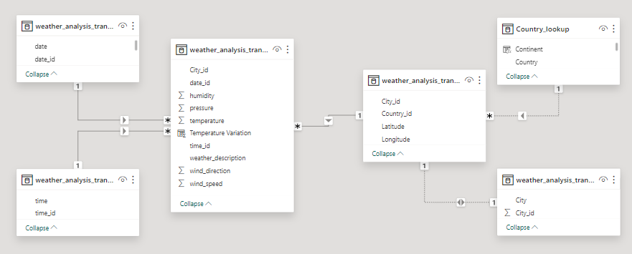
Data transformation

Slide 10
EDA Problem statement
03

Slide 11
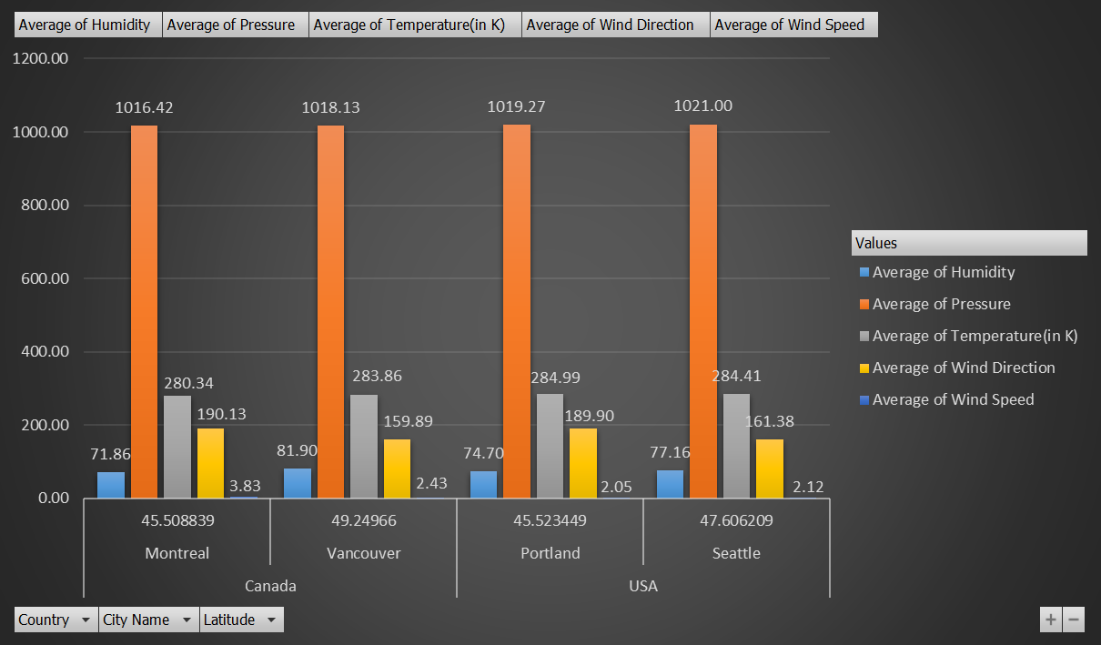
Analysis
Ques1 . Are there any countries with cities located at extreme latitudes, and how might this impact their climate?
Extreme latitude countries are those which lie on or above 60 degrees or below -60 degrees of the latitude and we don't have data for the same.
we will consider 45 degree as the extreme latitude lines.
Humidity: The graph indicates that humidity tends to increase with higher latitudes. This trend can also be observed in countries located at extreme latitudes.
Pressure: In general, air pressure decreases as latitude increases, and this trend is evident in the graph as well. However, Montreal is an exception, which may be due to other climatic factors.
Temperature: The graph shows that temperature decreases as latitude increases, which is a common trend. Montreal is an exception, and this may be due to other climatic factors and its longitudinal location.
Wind direction: It is clear from the graph that wind direction, measured in degrees, tends to decrease as latitude increases. This trend can also be observed in countries located at extreme latitudes.
Wind speed: Latitude has a limited impact on wind speed, which is mostly dependent on the longitudinal position of the country or city. Generally, coastal areas have higher wind speeds. Here, Montreal has a higher wind speed due to its location towards the western part.

Slide 12
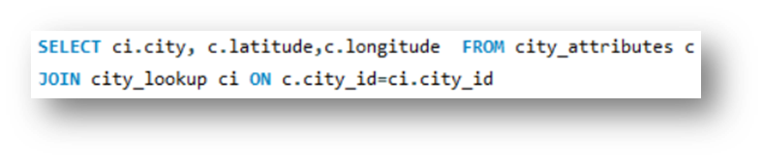
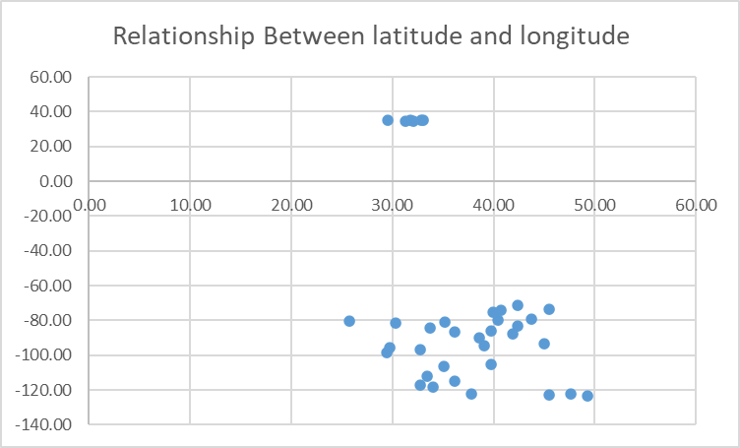
Analysis
Ques2 . Can you identify any clusters of cities with similar latitude and longitude values? What factors might explain these clusters?
Scatter plot gives a better picture to see how many cities have almost same latitude and longitude. Even though no country has same latitude and longitude but few of them almost have the same may be due to they are geographically more closer to each other.
Other factors explaining these clusters could include geographical regions, climate zones, or tectonic plate boundaries. Further analysis and domain-specific knowledge would be required to interpret the meaning of these clusters.

Slide 13
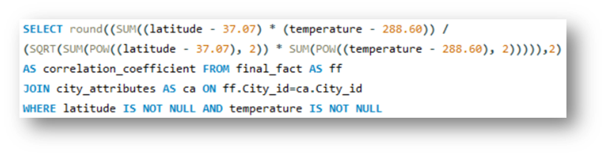
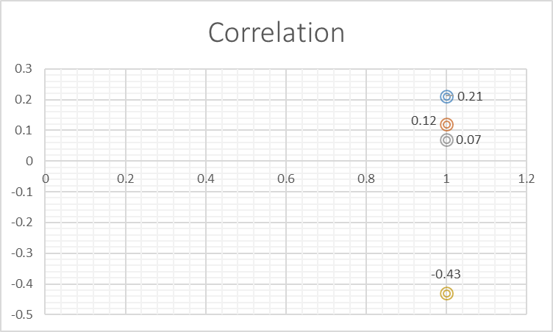
Analysis
Ques3 . Are there any correlations between a city's geographical location (latitude and longitude) and its weather attributes, such as temperature or humidity?
A correlation of -0.43 between latitude and temperature suggests a moderate negative relationship. Which means as the latitude increases the temperature will decrease.
A correlation of 0.07 between longitude and humidity suggests there is no direct or indirect effect of longitude on humidity.
A correlation of 0.12 between latitude and humidity suggests there is no direct or indirect effect of latitude on humidity.
A correlation of 0.21 between latitude and temperature suggests there is no direct or indirect effect of longitude on temperature.

Slide 14
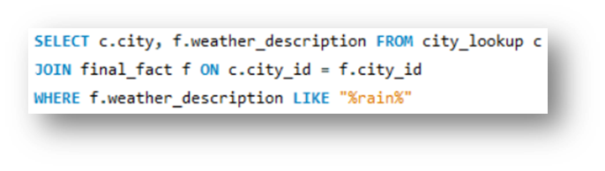
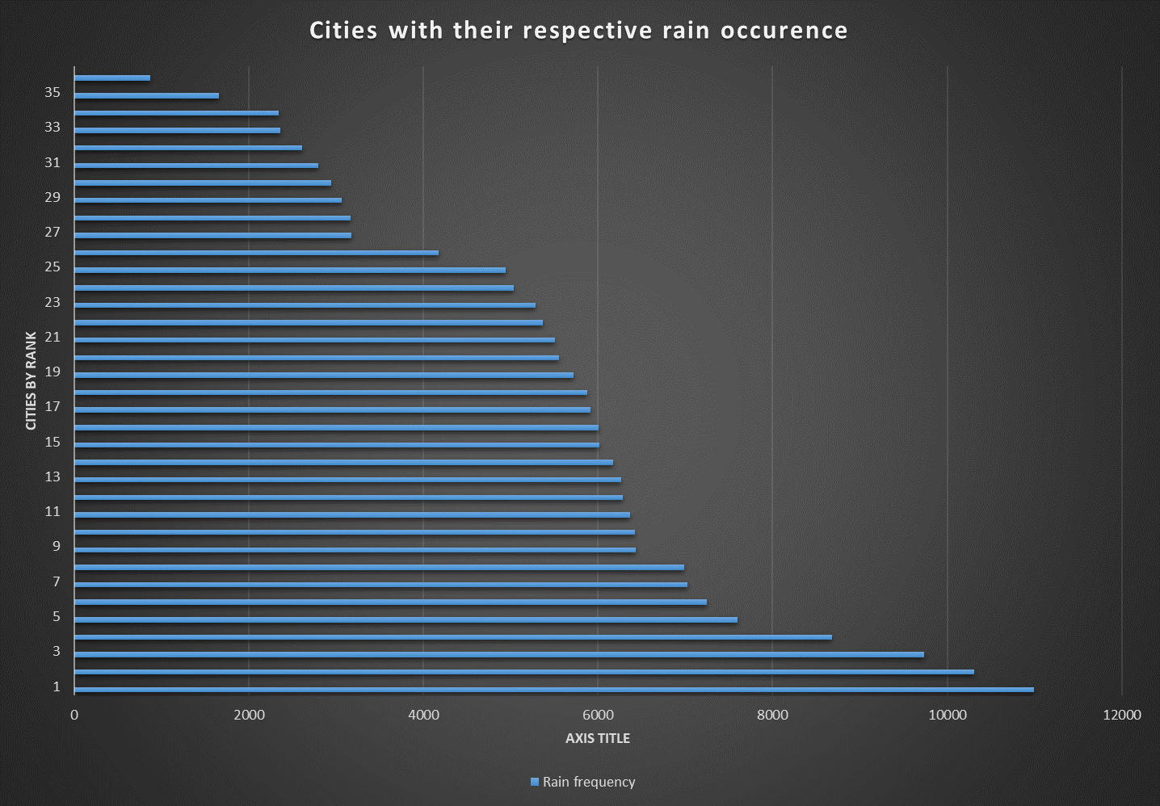
Analysis
Ques4 . Identify the top three cities with the most frequent occurrence of rainy weather based on weather descriptions. What are the seasonal patterns?
After retrieving data from mysql, new table is made with 3 columns. Countif formula to count number of occurrence of rain in particular city.
And rank them in descending order to highlight the top 3 cities with highest frequent occurrence of rainfall i.e. Portland, Vancouver and Seattle respectfully.
For more info on analysis, check Excel sheet or Project report

Slide 15
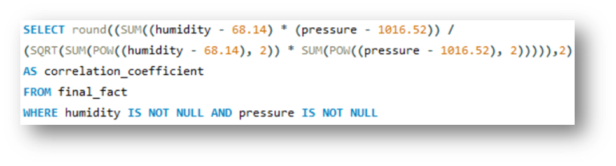
Analysis
Ques5 . Is there a correlation between humidity levels and air pressure? How might this relationship affect weather conditions?
First, we have calculated the average humidity and average pressure.
Correlation apply the correlation formula.
A correlation of 0.08 between humidity and air pressure suggests a weak or negligible relationship. In practical terms, this correlation is unlikely to have a significant impact on predicting or understanding weather patterns.

Slide 16
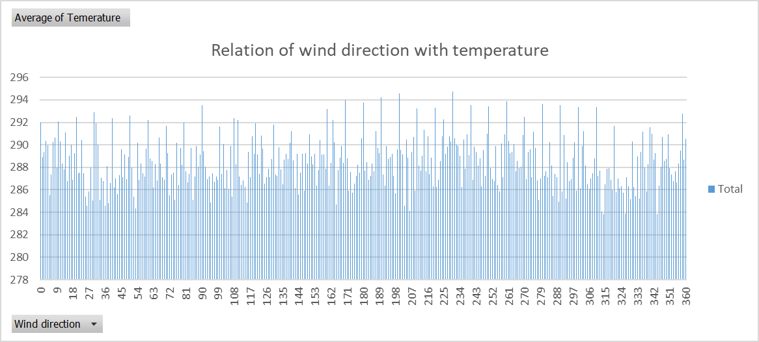
Analysis
Ques6 . Explore the impact of wind direction on temperature for coastal cities. Are there noticeable patterns?
It is visible from the graph that the temperature is relatively high when the wind direction is between 155 to 270 degrees.
Whereas, temperature is relatively low when the wind direction is lesser than 140 or greater than 270. This is the data for only coastal cities only (Slicer is applied to analyse the data of only coastal cities).

Slide 17
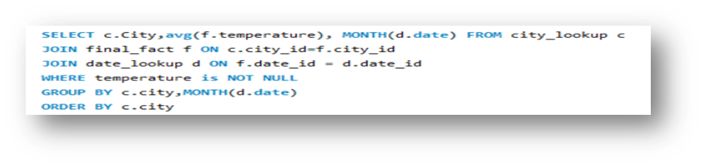
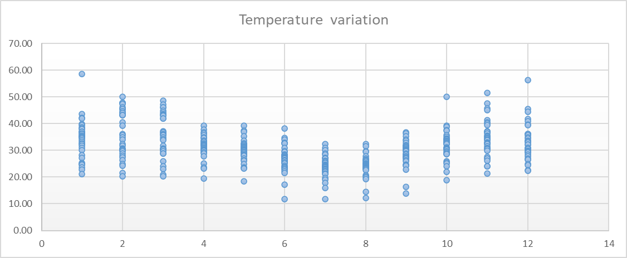
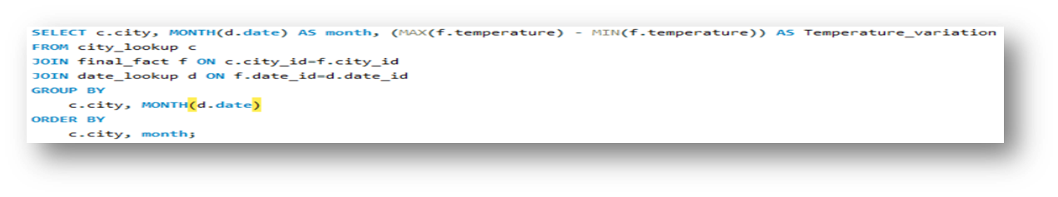
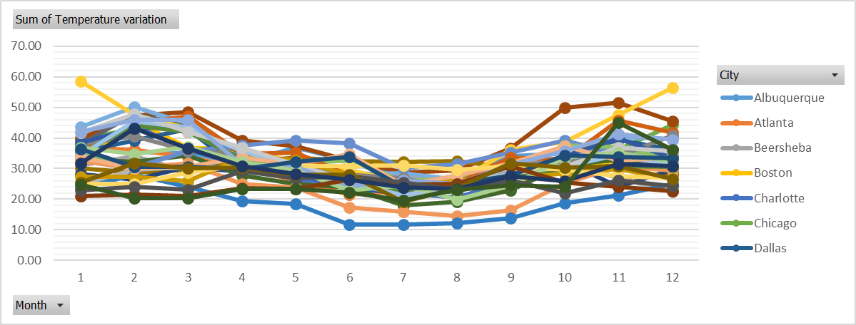
Analysis
Ques7 . Are there specific months when cities experience significant temperature fluctuations? What might explain these variations?
Kansas city experience the highest temperature fluctuation. Specifically, in the month of January, February and December.
Similarly, most of the cities faces high temperature fluctuation/variation in the month of February, January and December respectively. These are the months with the highest temperature fluctuation. On the other hand, June, July and August sees the lowest temperature fluctuation respectively.
It is also seen that coastal cities like Miami, Jacksonville and Houston experience the least temperature fluctuation throughout the year.

Slide 18
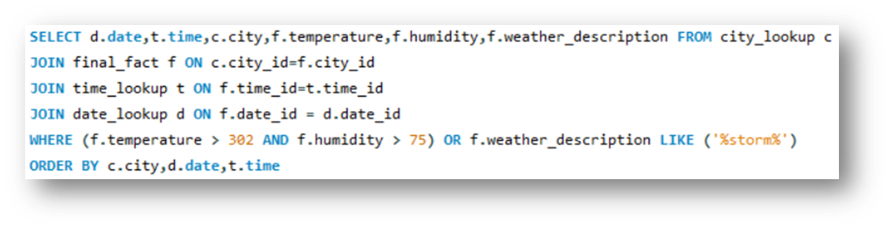
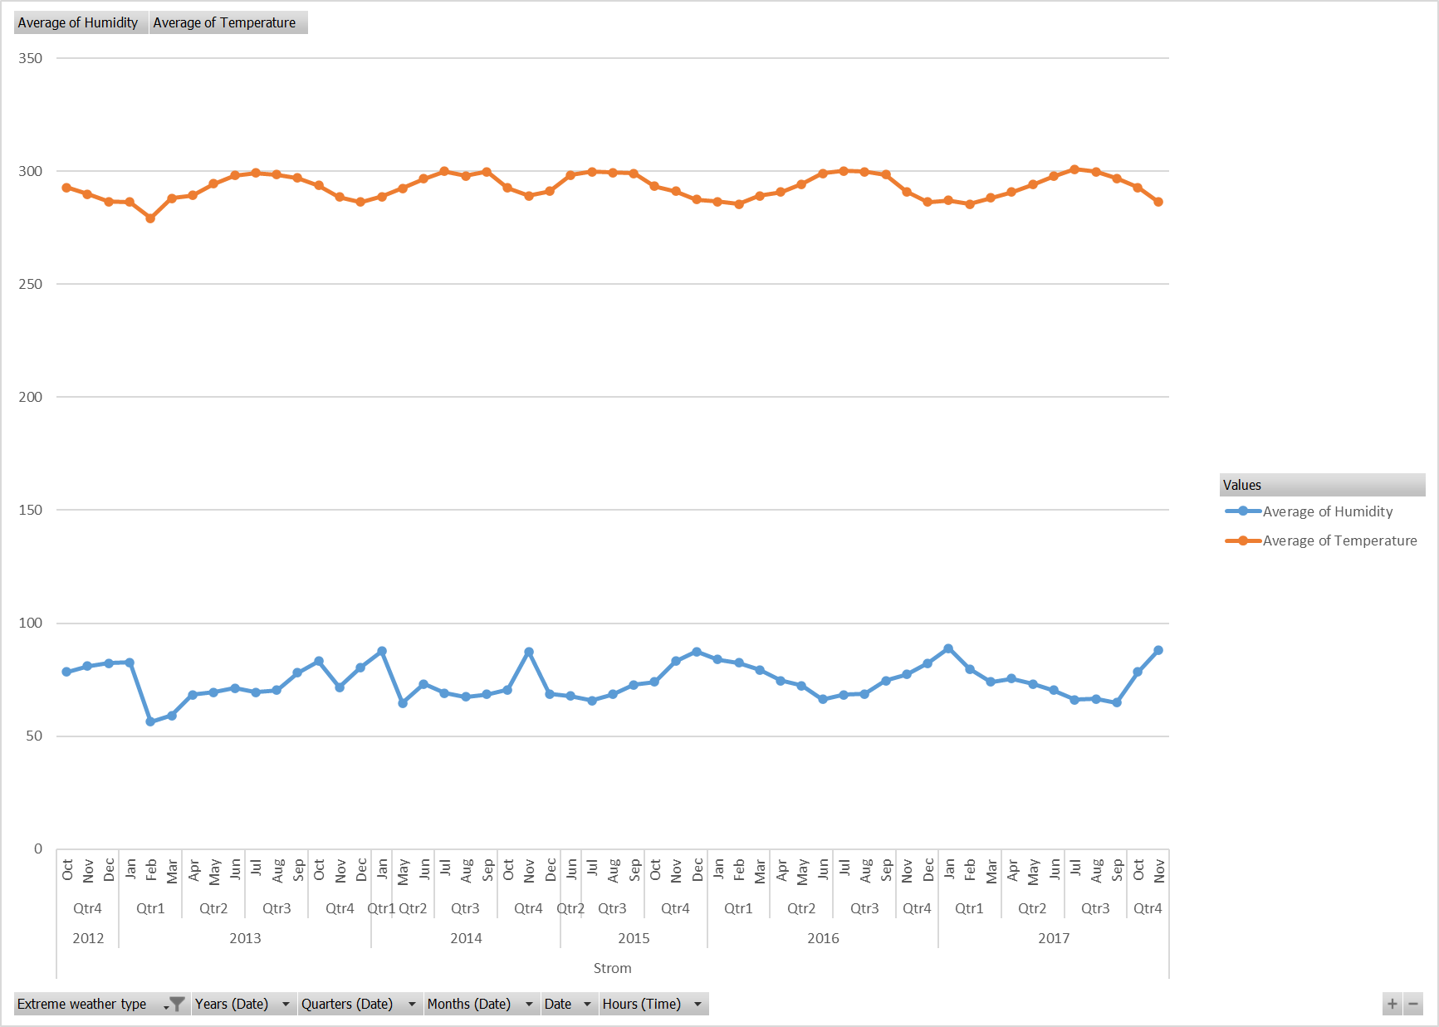
Analysis
Ques8 . Identify periods of extreme weather events, such as storms or heatwaves, by analyzing the time-based data. What patterns emerge?
To analyse extreme weather conditions i.e., storms and heatwaves, it is easier to print the data for storms as we have the weather description having information on storms. Categorising the extreme weather condition between storm and heatwave using IF function.
Humidity during the storm is way less than the humidity during the heatwaves. Same is the case for the temperature.
Month of February, December and January has relatively lesser temperature as compared to other months.
Month of March and April comparatively have lesser humidity as compared to other states.
Quarter 2 (April, May, June), records the higher temperature and December and January records the higher Humidity as compared to other months.

Slide 19
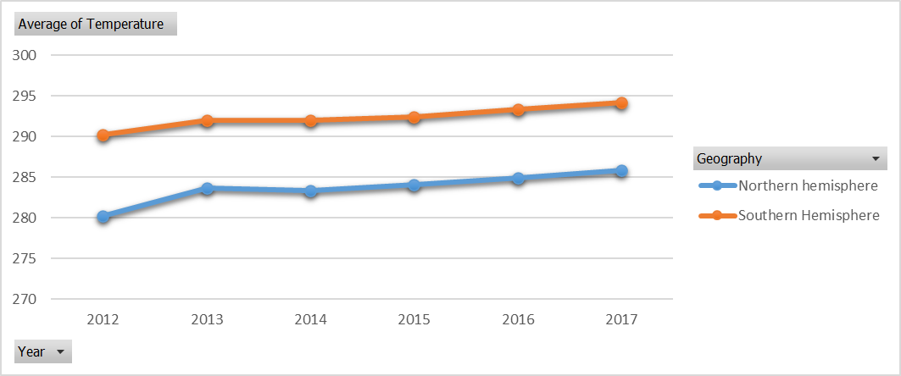
Analysis
Ques9 . Are there any notable differences in temperature trends between northern and southern hemisphere cities over the year? How do they relate to seasons?
Taking 37.5 as the equator and the city above 37.5 as northern hemisphere and below that as southern hemisphere (IF condition is used).
The northern hemisphere has the higher average temperature as compared to the countries situated in the southern hemisphere. Reason could be countries in the southern hemisphere are much closer to the equator.
Year by year the average temperature is increasing which is an alarming thing and global warming is a very serious concern.
The periods of winters are getting shorter whereas summers are getting hotter and longer.

Slide 20
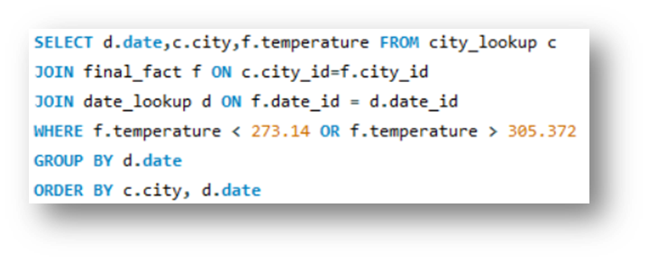
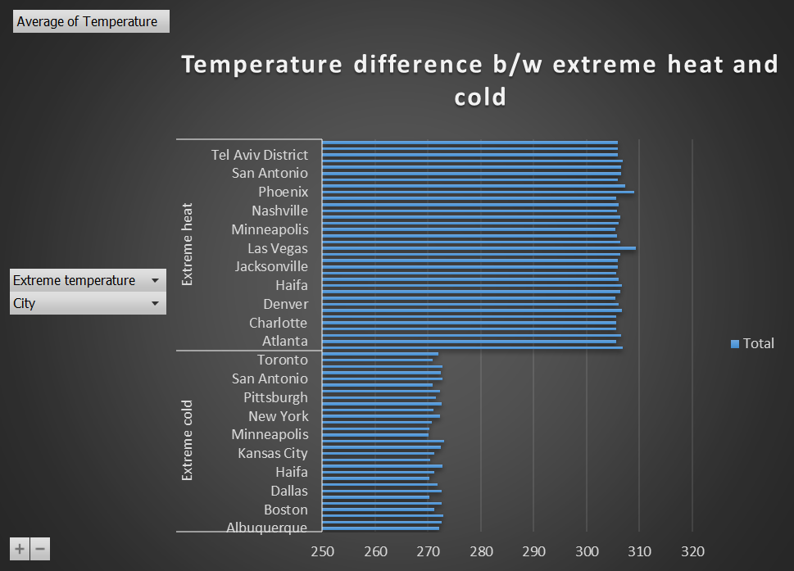
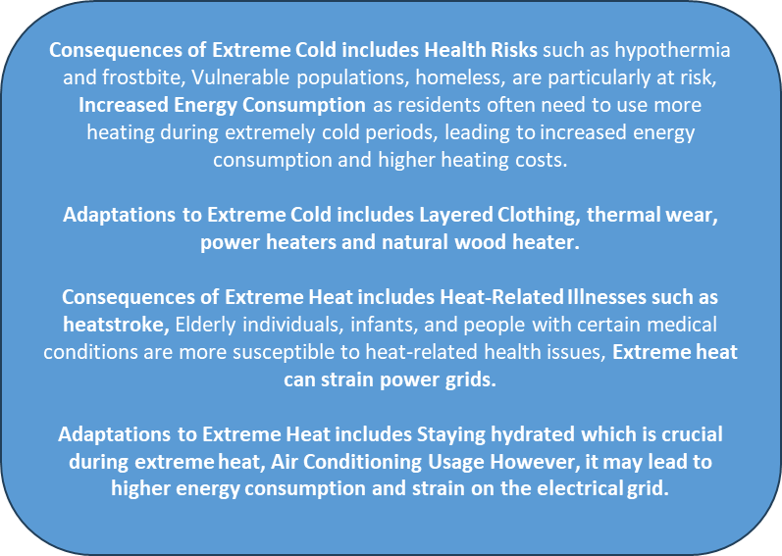
Analysis
Ques10 . What are the consequences of prolonged periods of extreme cold or heat in specific cities? How do residents adapt to such conditions?
Extreme cold temperature is considered for the reading below 273.14 K and extreme hot temperature is considered when the temperature is more than 305.372.
New column is formed to distinguish between Extreme heat and extreme cold cities.

Slide 21
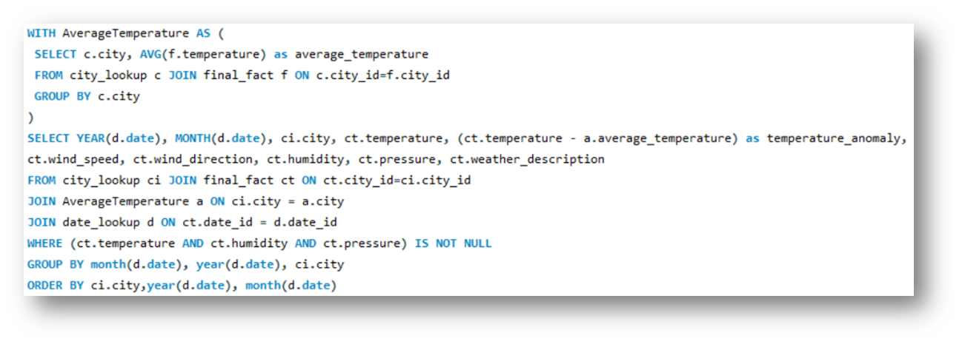
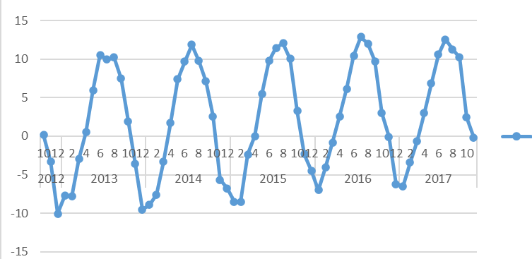
Analysis
Ques11 . Investigate whether temperature anomalies (unusual deviations from the norm) coincide with certain events or environmental factors in specific cities.
To investigate whether temperature anomalies coincide with certain events or environmental factors in specific cities we have to follow some steps:
Calculate the average temperature for each city.
Determine the anomaly by subtracting the average temperature from the temperature of each record of each months.
From the graph, it is evident that the month of January and December have more negative temperature anomaly and month of June, July and August have higher positive temperature anomaly.

Slide 22
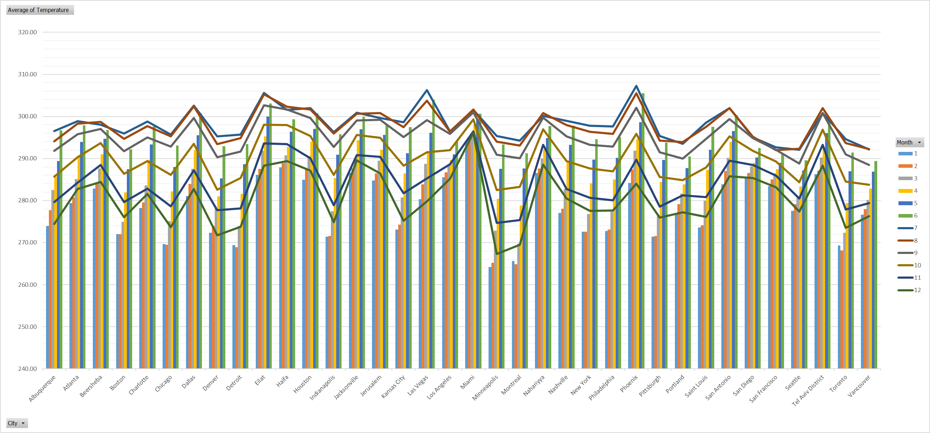
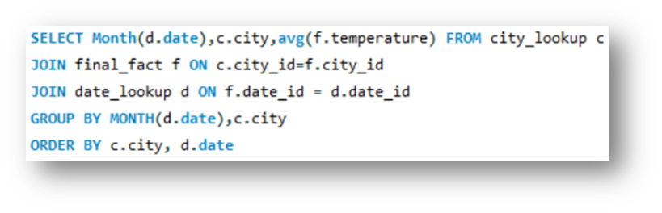
Analysis
Ques12 . Analyze the impact of temperature on energy consumption patterns in cities. Are there noticeable trends or correlations?
Energy consumption is high either there is extreme cold or relatively higher temperature with high humidity.
Extreme cold temperature is considered for the reading below 273.14 K and relative high temperature is considered when the temperature is more than 299.76. New column is formed to distinguish between Extreme heat and extreme cold cities. (IF(OR) function is used.)
January, February, April, May, June and December has the high consumption of energy.

Slide 23
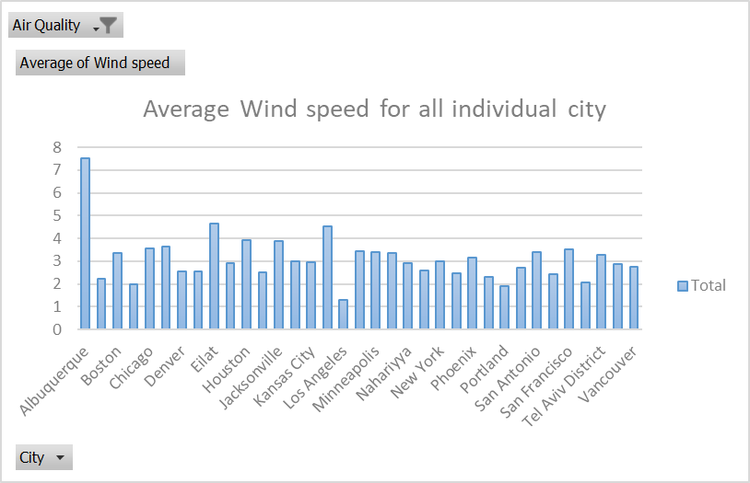
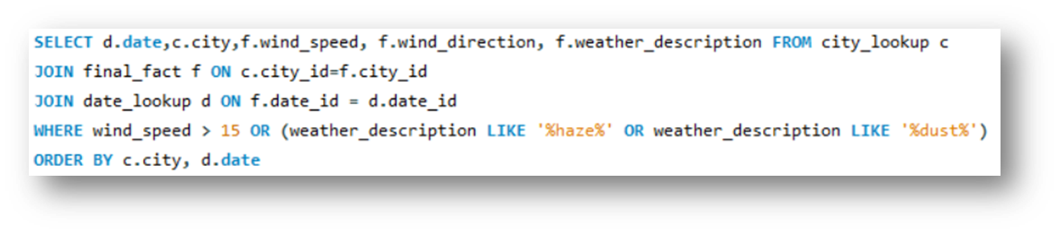
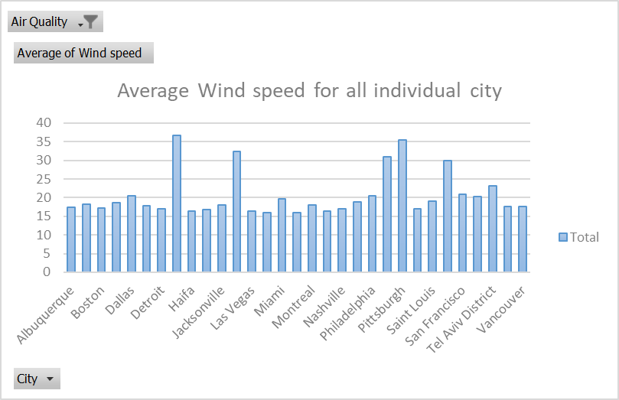
Analysis
Ques13 . How do specific wind patterns impact air quality and pollution dispersion in urban areas? Analyze wind direction data for insights.
Conclusion from the chart and table:
The wind speed is less than 15, the AQI is bad as the pollutants didn't gets sweep away with air. On the other hand, when the wind speed is more than 15, the air quality is better.
Wind direction(in degrees) is between 150 to 220, the AQI is bad. When the wind direction is less than 130 or more than 220 then the AQI is noticed to be good.

Slide 24
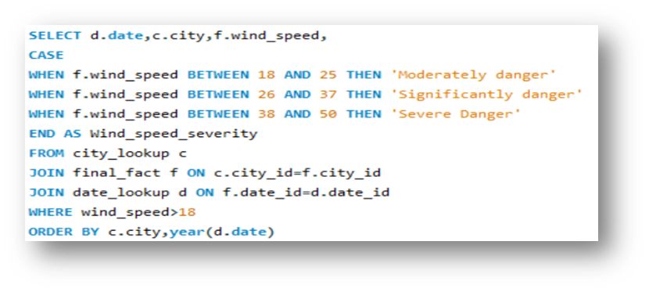
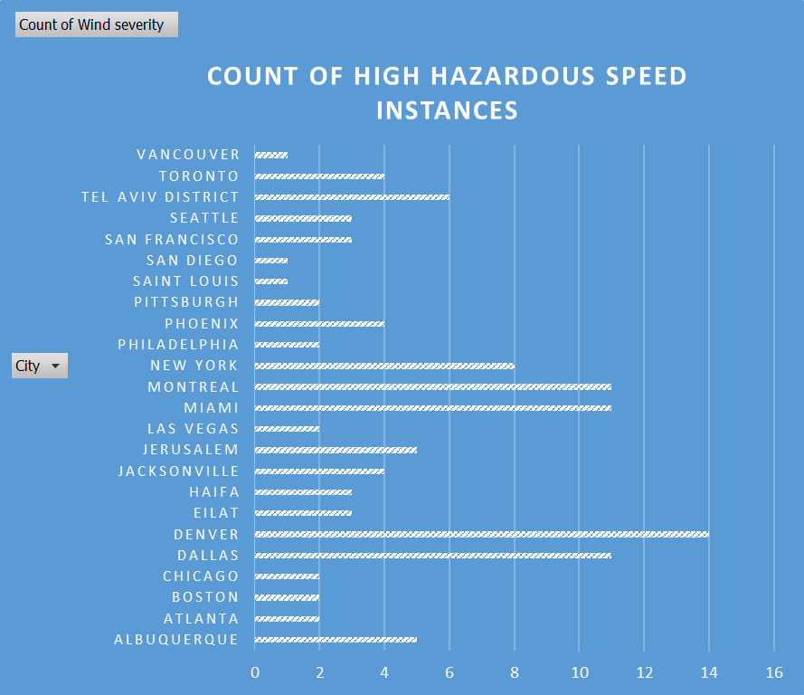
Analysis
Ques14 . Identify cities prone to strong winds and the potential consequences, such as increased risk of natural disasters or challenges for transportation.
Denver, Dallas, Miami and Montreal are the cities which witness high wind speed which may cause some damage to the people and property. Even though, all the wind intensity aren't severe, most of it are moderately danger.
Most of the Israel's cities falls under severe danger category. Tel Aviv, Jerusalem and Eilat are the cities with severe wind intensity and all these cities belongs to Israel. Single instance of severe wind was also observed in few USA cities which are San Francisco, Dallas and Phoenix.
Hence , these are some of the cities which are prone to increased risk of natural disasters or challenges for transportation.

Slide 25
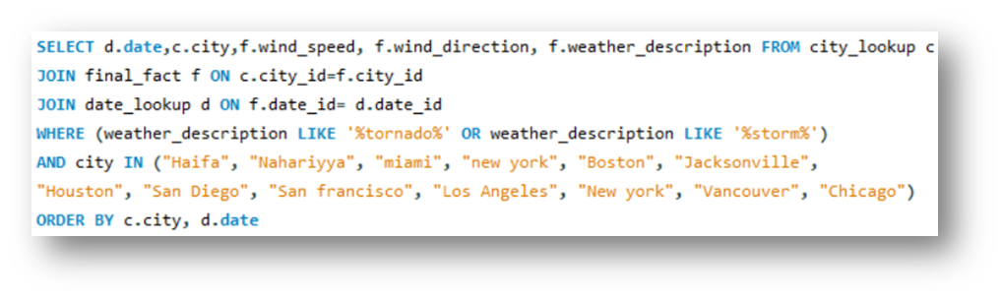
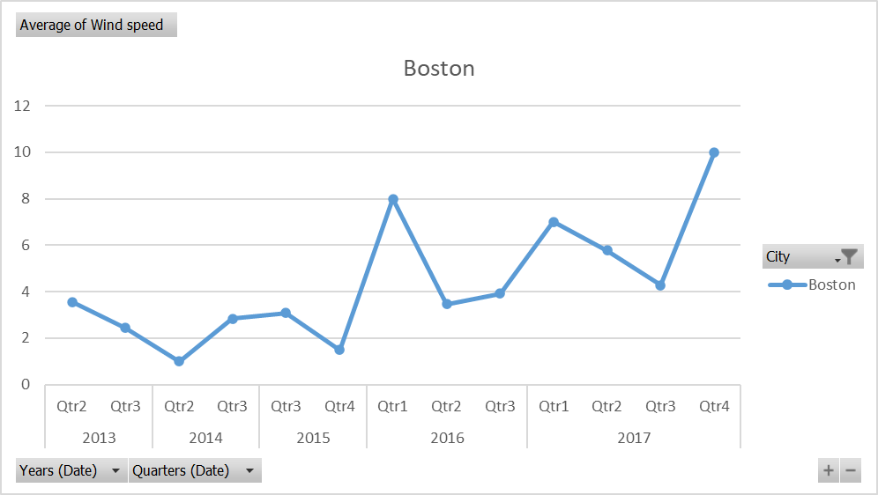
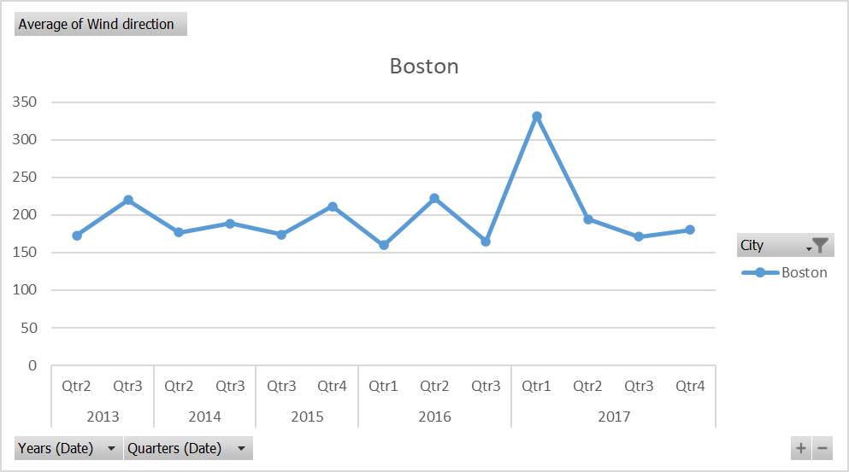
Analysis
Ques15 . Explore whether wind speed and direction influence the frequency and severity of weather-related events (e.g., hurricanes, storms) in coastal cities.
Most of the cities follow the same pattern i.e., either they have 0 degrees or more than 120 degrees.
Wind direction also depends on the longitudinal and latitudinal position of the city so it is not possible to draw a conclusion that what exact pattern does wind direction follows.

Slide 26
PowerBI Problem statement
04

Slide 27
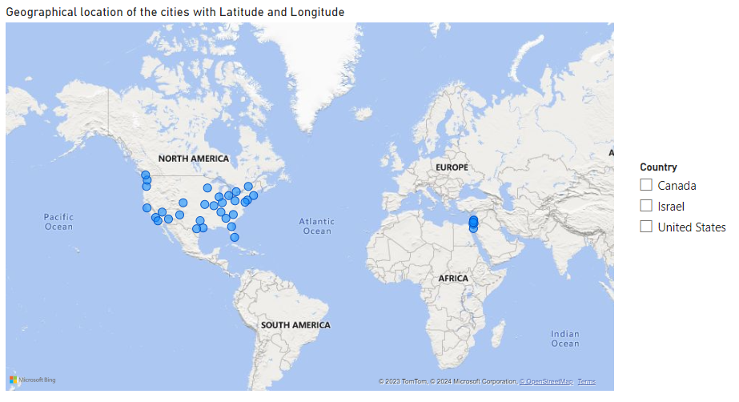
PowerBI Analysis
Ques1 . Can you create a geographical map in Power BI showing the distribution of cities in the dataset based on their latitude and longitude?

Slide 28
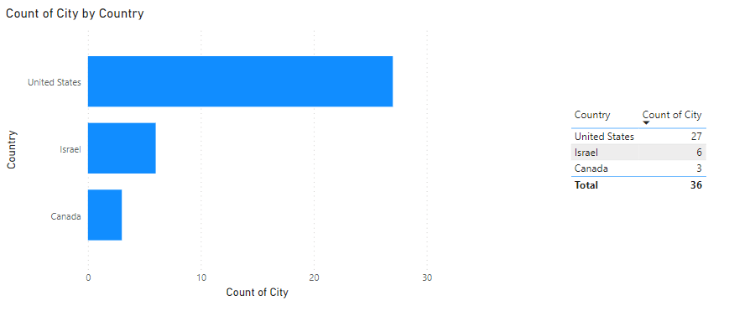
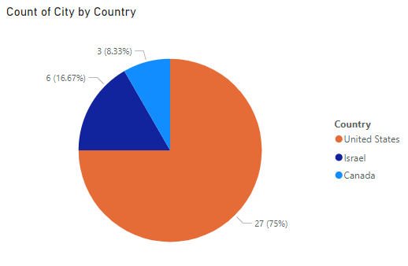
PowerBI Analysis
Ques2 . In Power BI, can you create a bar chart representing the top 10 countries with the highest number of cities in the dataset?

Slide 29
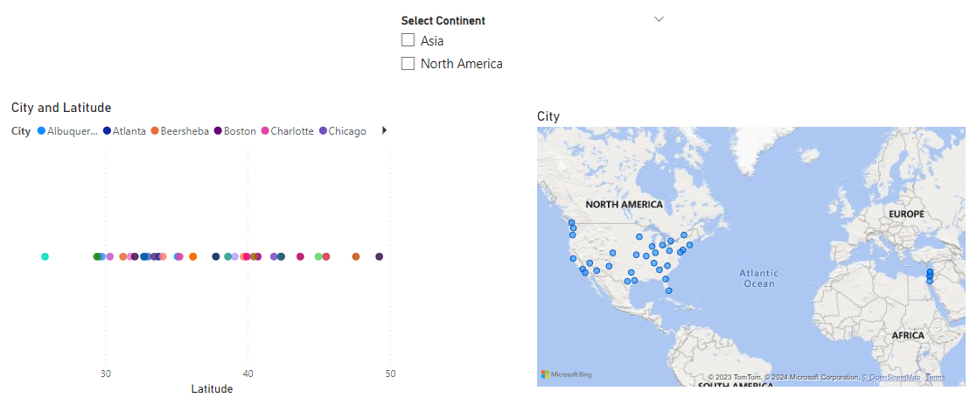
PowerBI Analysis
Ques3 . How does the distribution of cities in terms of latitude vary across different continents? Create a scatter plot in Power BI to illustrate this.

Slide 30
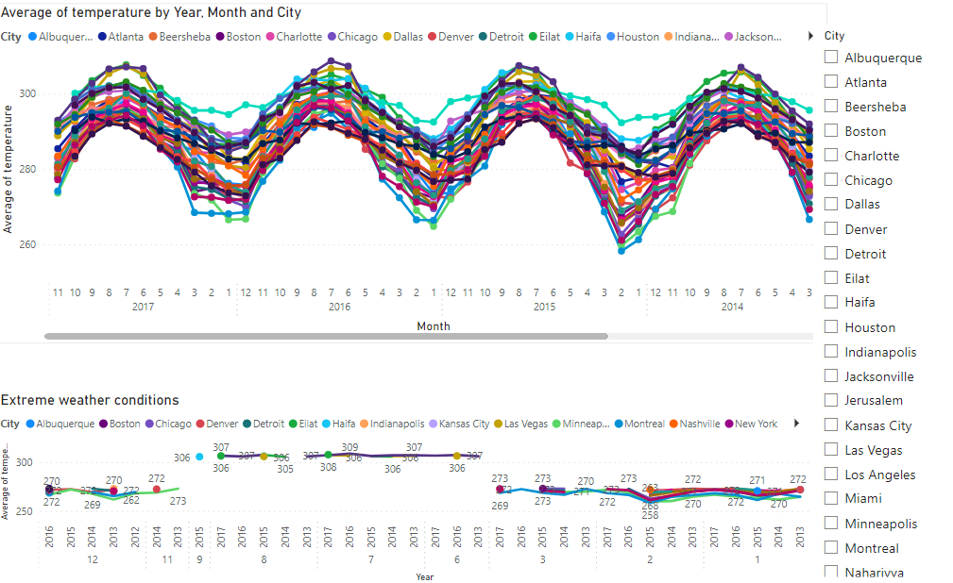
PowerBI Analysis
Ques4 . Create a line chart in Power BI to display the temperature trends over time for a selected city. Highlight extreme temperature events.

Slide 31
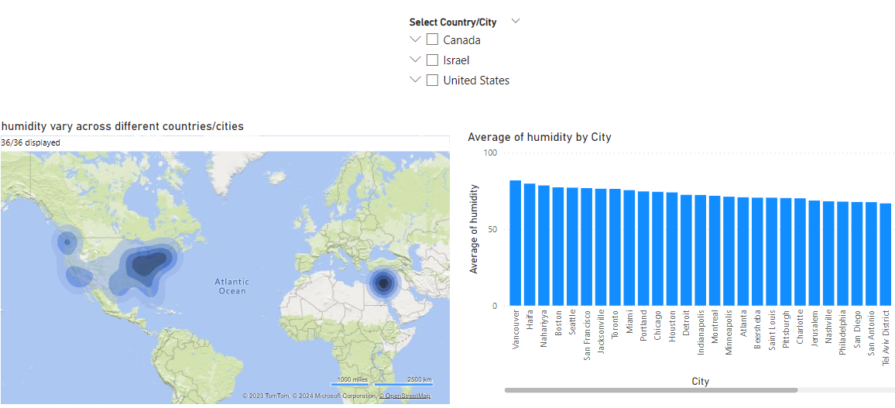
PowerBI Analysis
Ques5 . How does humidity vary across different cities? Generate a heatmap in Power BI to visualize this variation.

Slide 32
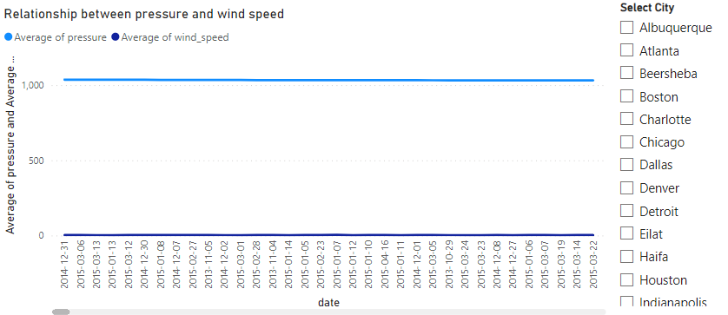
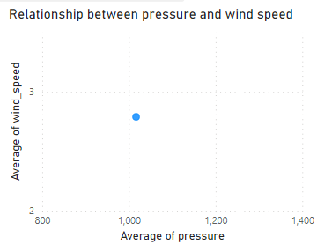
PowerBI Analysis
Ques6 . Can you create a time-series chart in Power BI showing the relationship between wind speed and air pressure for a specific city?

Slide 33
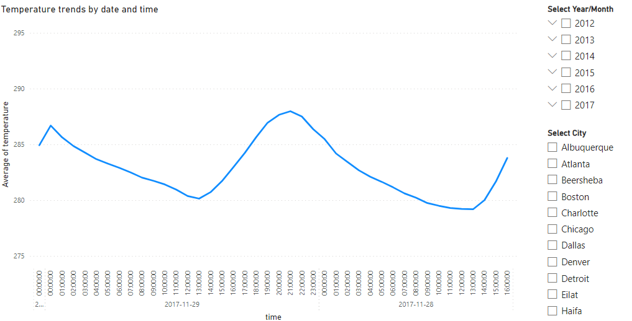
PowerBI Analysis
Ques7 . Create a time-series line chart in Power BI to show the overall temperature trends over the entire dataset.

Slide 34
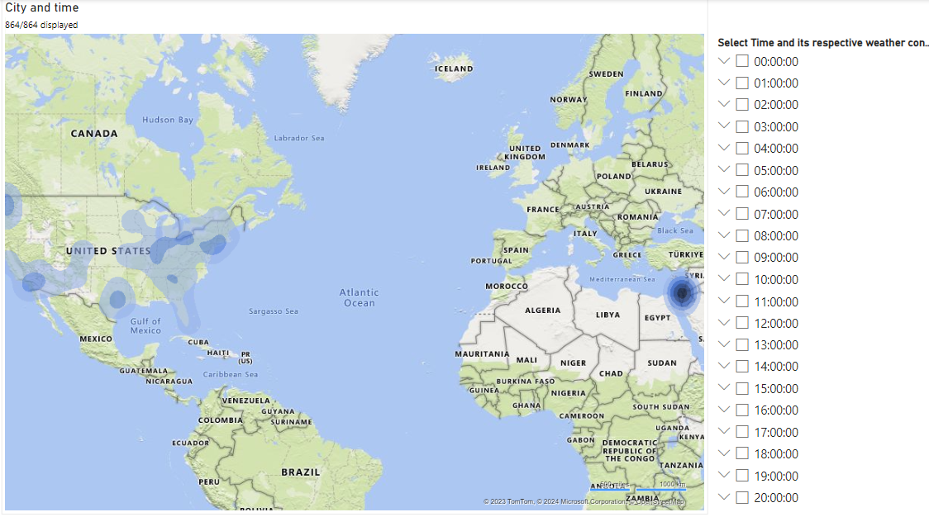
PowerBI Analysis
Ques8 . Can you create a heatmap in Power BI to visualize the busiest hours for specific weather conditions (e.g., "clear sky," "rainy")?

Slide 35
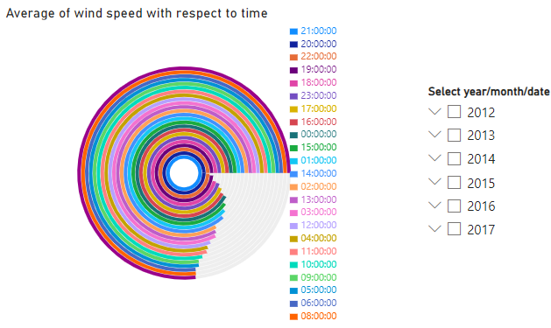
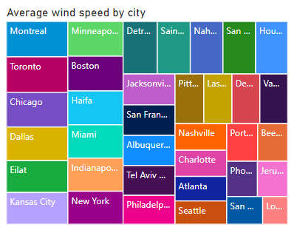
PowerBI Analysis
Ques9 . How does the wind speed change over the course of a day? Create a radial chart in Power BI to represent this.

Slide 36
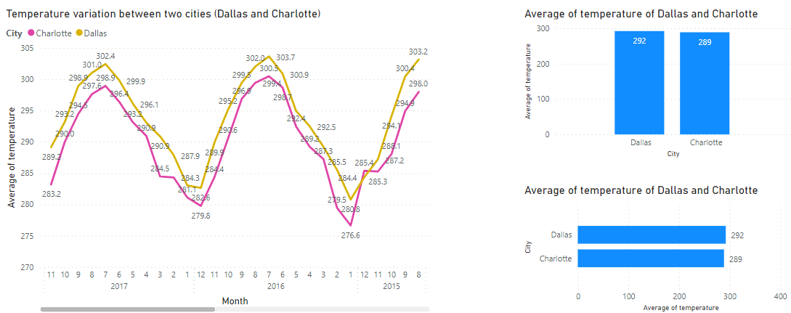
PowerBI Analysis
Ques10 . Create a Power BI chart comparing the temperature variations between two selected cities over a specific timeframe.

Slide 37
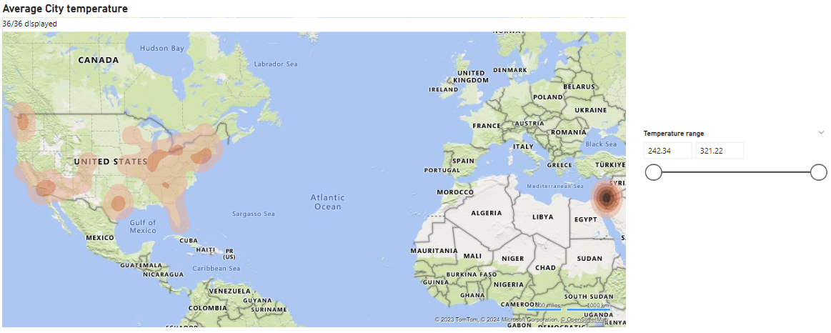
PowerBI Analysis
Ques11 . Can you build a heatmap in Power BI to show the temperature ranges for cities across different countries?

Slide 38
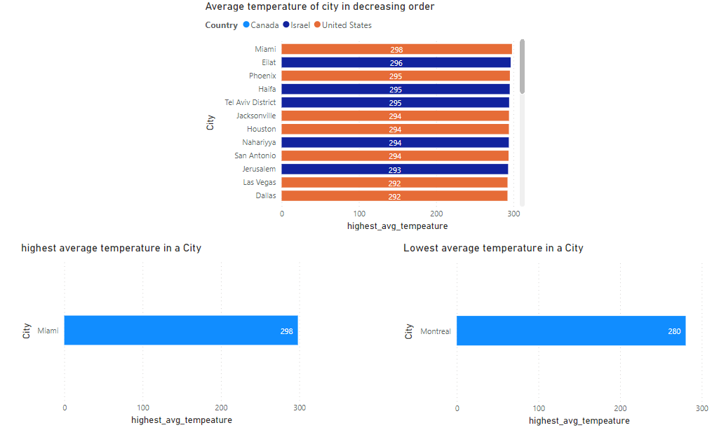
PowerBI Analysis
Ques12 . Create a bar chart in Power BI to highlight cities with the highest and lowest average temperatures in the dataset.

Slide 39
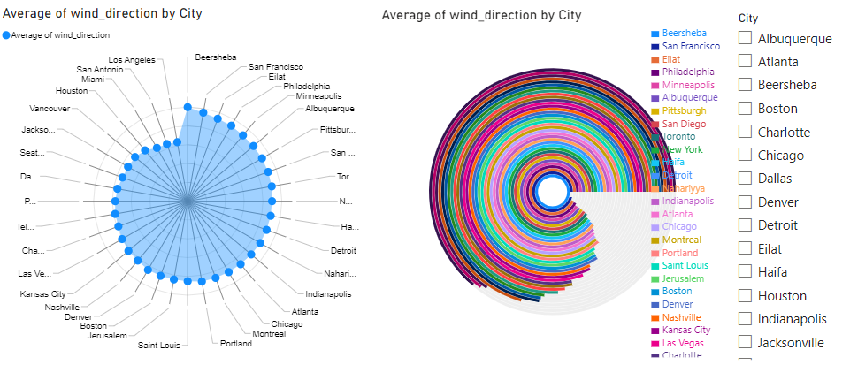
PowerBI Analysis
Ques13 . Create a wind rose chart in Power BI to visualize the prevailing wind directions for a selected city.

Slide 40

PowerBI Analysis
Ques14 . Can you generate a Power BI heatmap illustrating the average wind speeds across cities for different months of the year?

Slide 41

PowerBI Analysis
Ques15 . Create a Power BI scatter plot to show the relationship between wind speed and air pressure for a specific city.

